Slide 1
Applications of Daily Life Sampling in Clinical Populations
Maddy Frumkin, PhD
Assistant Professor
Center for Technology and Behavioral Health
Departments of Biomedical Data Science and Psychiatry
Geisel School of Medicine at Dartmouth

Slide 2
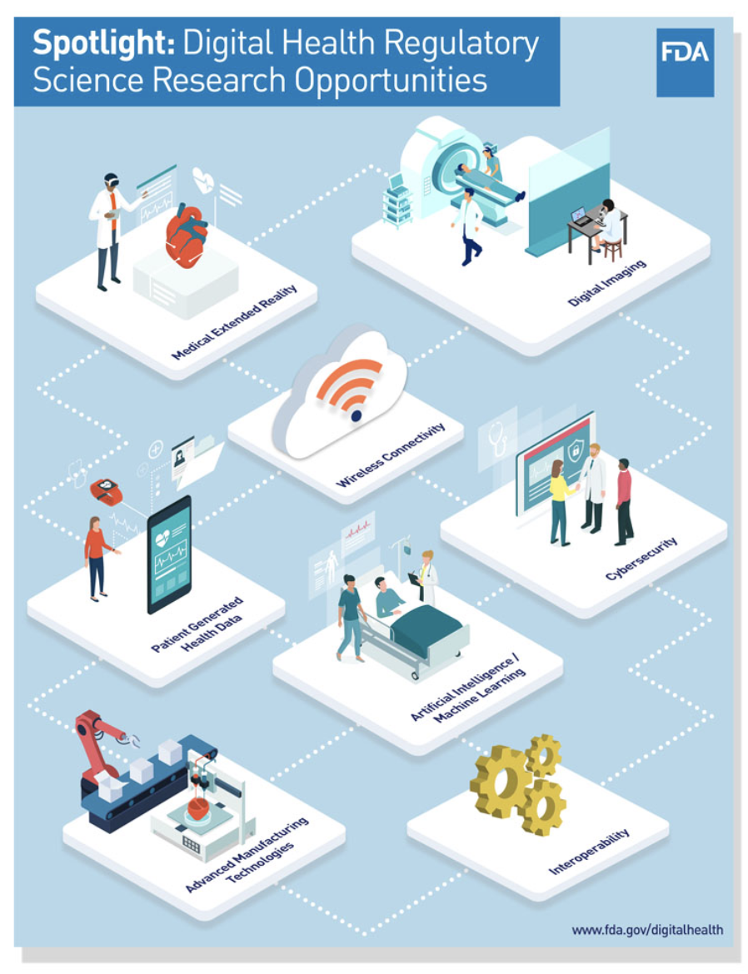
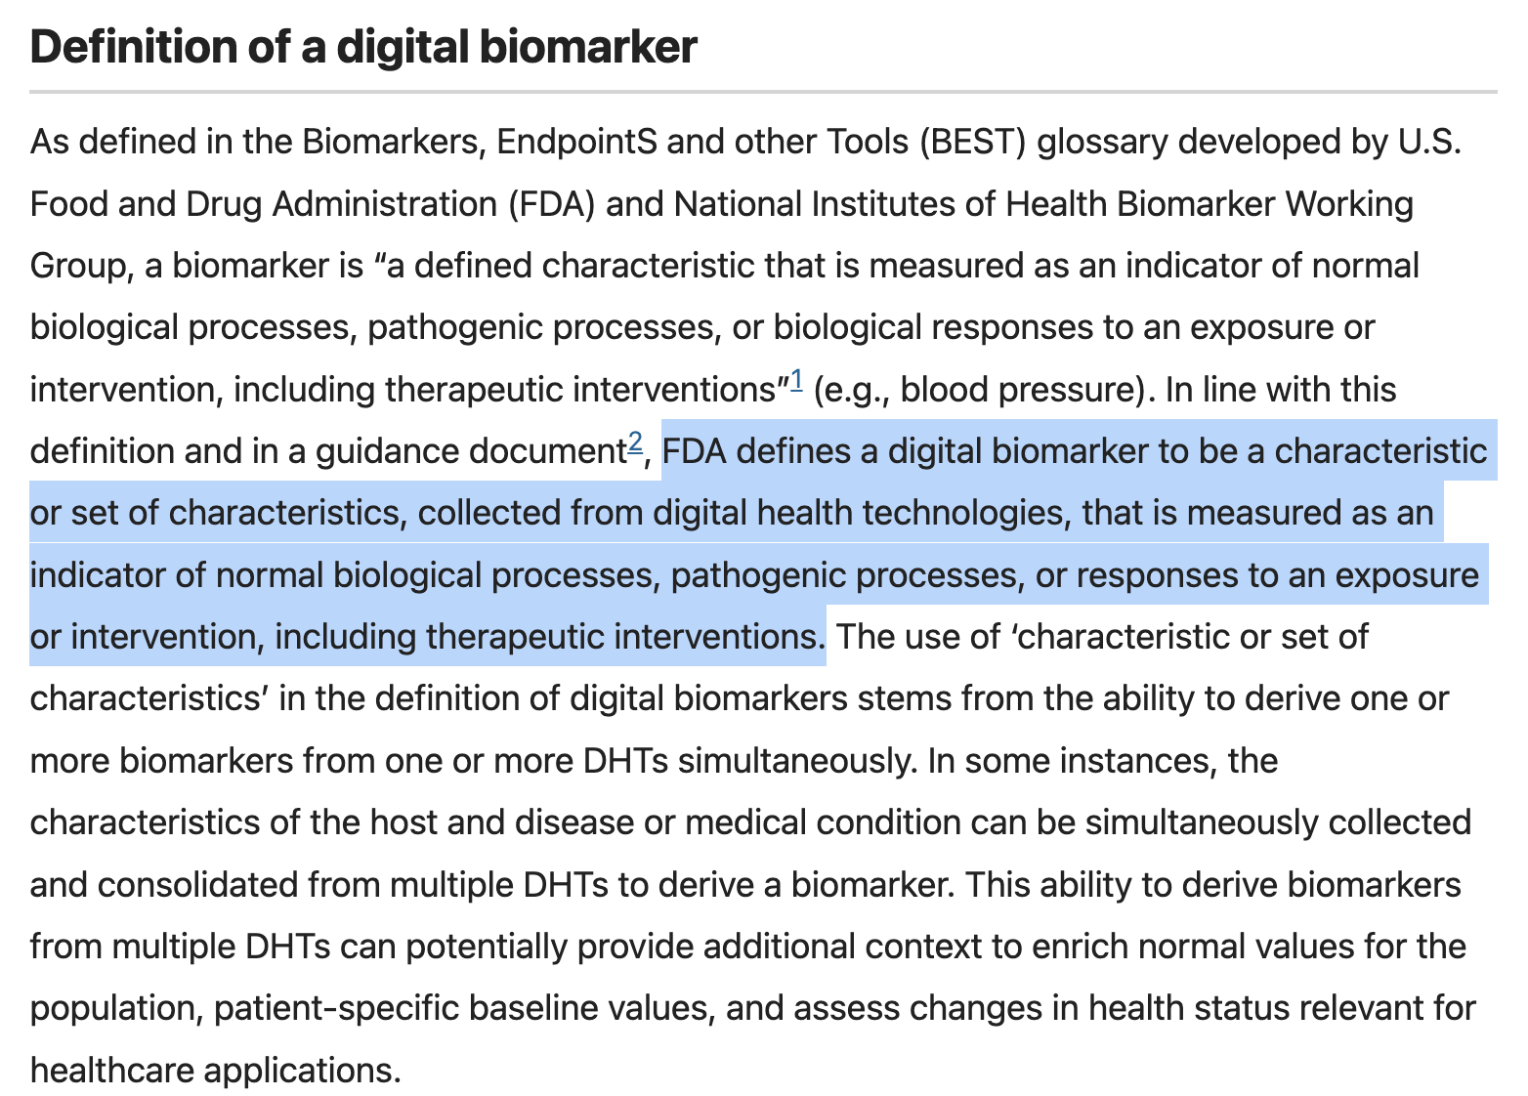

Slide 3
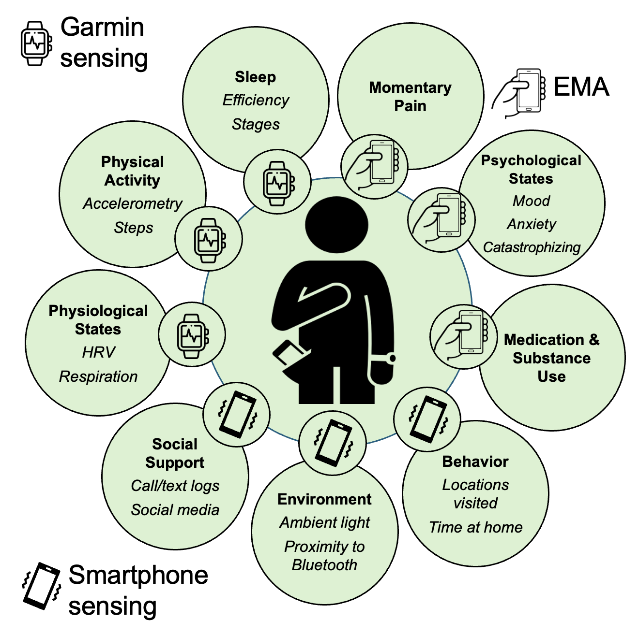
Why digital biomarkers?
Retrospective recall of symptoms is biased by the individual’s most recent and most severe experiences (Horowitz et al., 2023; Stone et al., 2004; Stone et al., 2000)
Self-report tends to have low agreement with objective measurement (Collins et al., 2025; Lauderdale et al., 2008; Prince et al., 2008; Varallo et al., 2022)
Longitudinal monitoring facilitates investigation of symptom dynamics

Slide 4
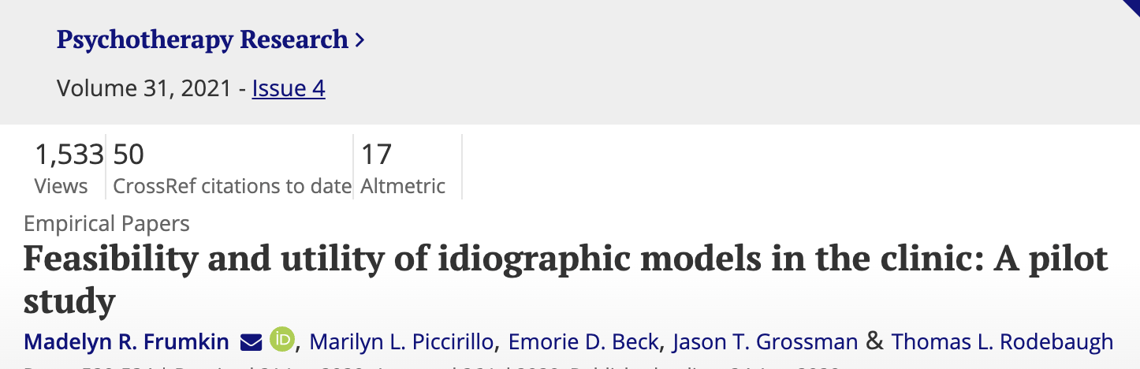
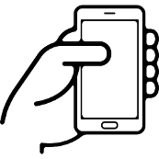
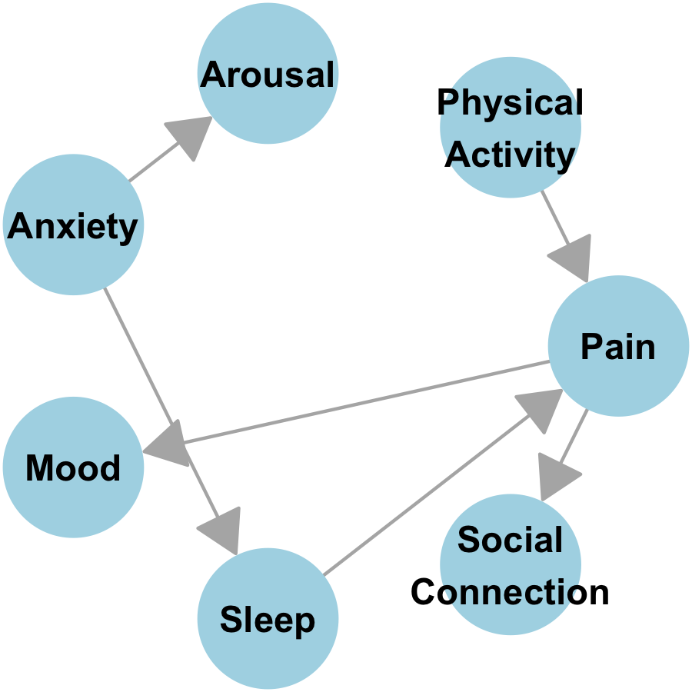
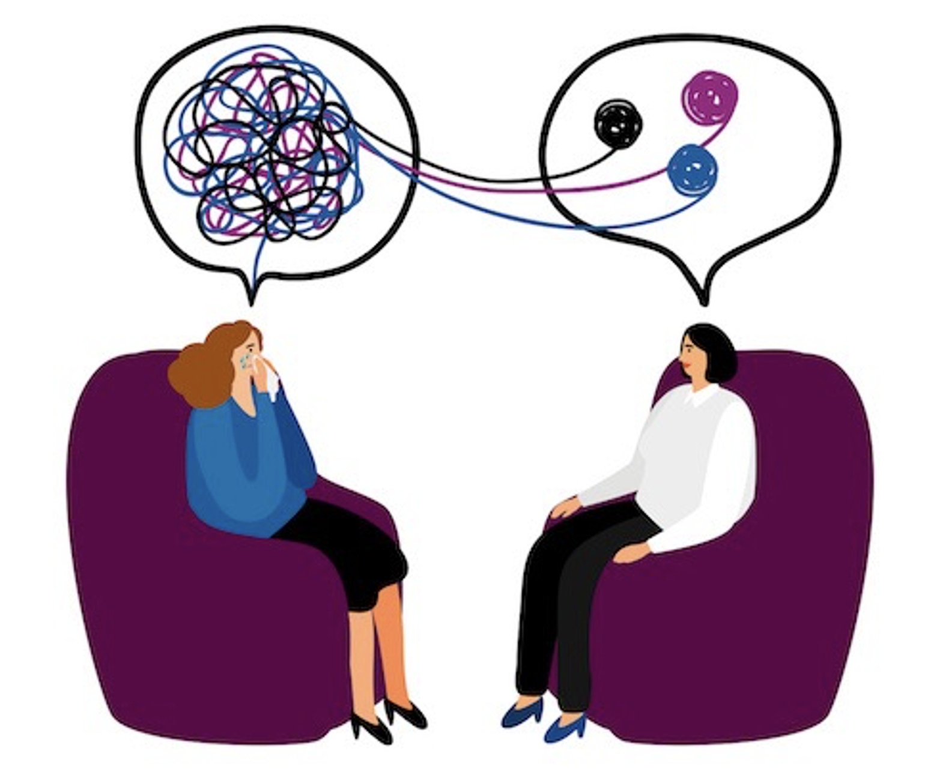

Paper

Slide 5
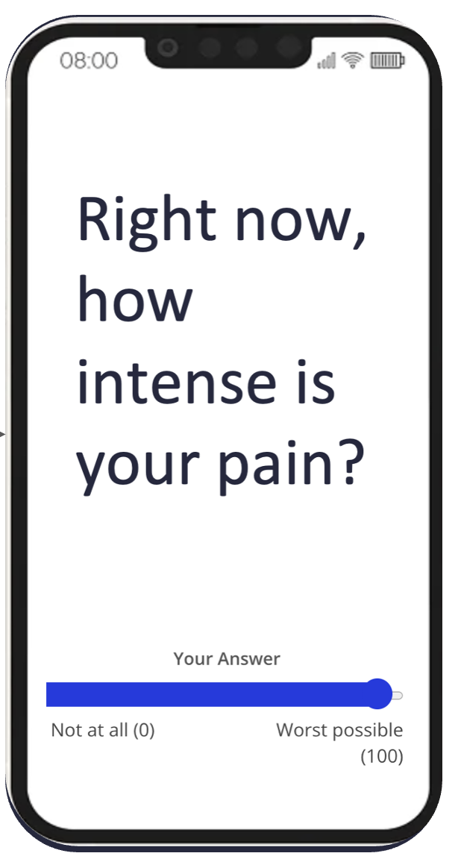

Digital assessment is highly feasible
2,500 patients undergoing surgery (30% have chronic pain)
91% completed any ecological momentary assessment (not required nor directly incentivized)
Without excluding participants based on low compliance, we observed high preoperative (Median = 80%) and postoperative (Median = 72%) compliance with EMAs delivered 3x per day
Weak positive association with age
Preprint

Slide 6
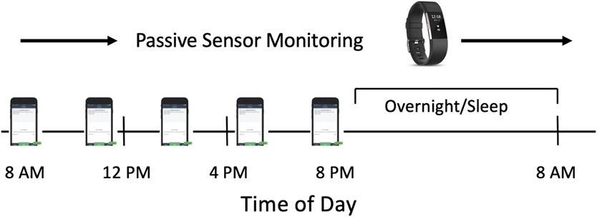
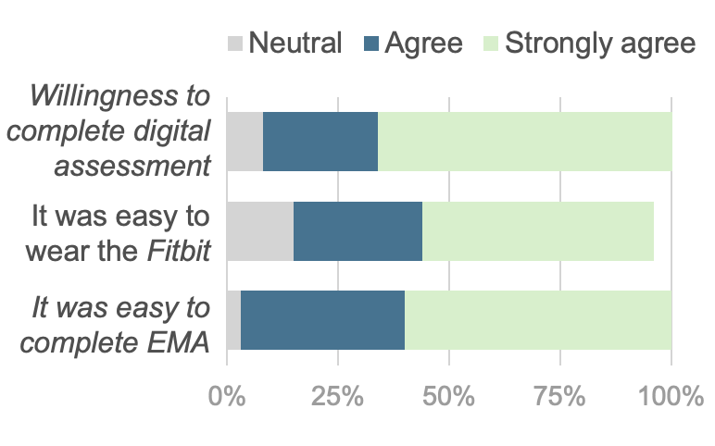

Digital assessment is highly feasible
77 patients undergoing spine surgery
86% compliance with EMA 5x/day for 3 weeks before surgery
High willingness to complete digital assessment
Paper

Slide 7

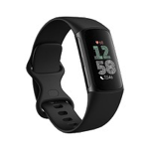
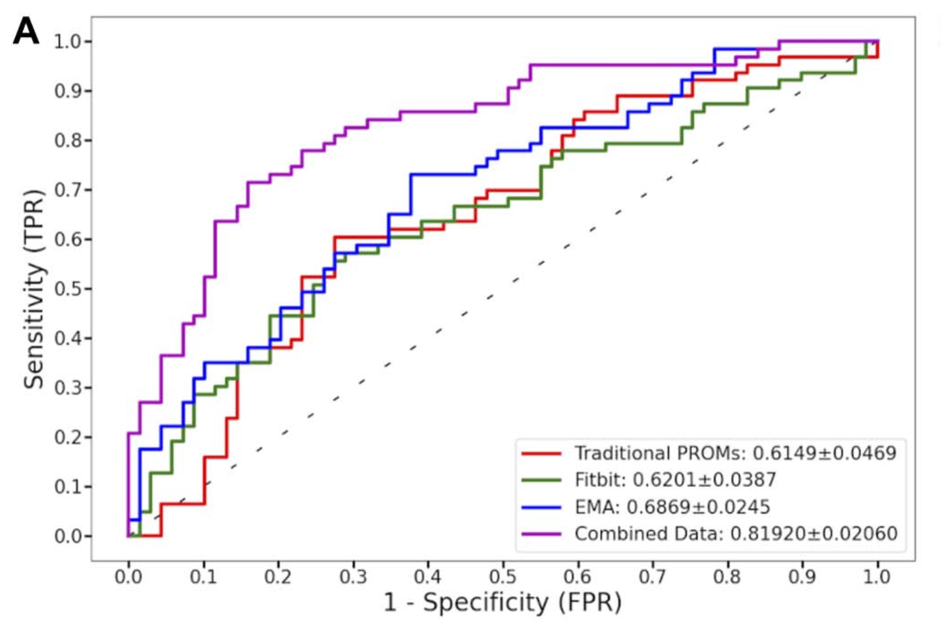

Digital assessment improves prediction of surgery outcomes
133 patients undergoing lumbar surgery for degenerative spine disease
Features derived from digital health data led to a 34% improvement in predictions of postoperative outcomes
Paper

Slide 8
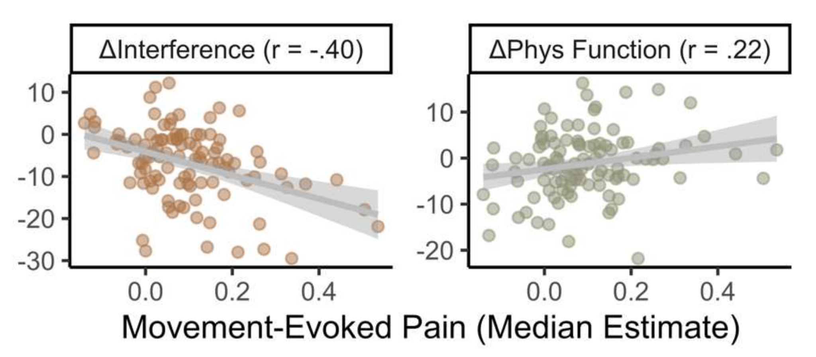
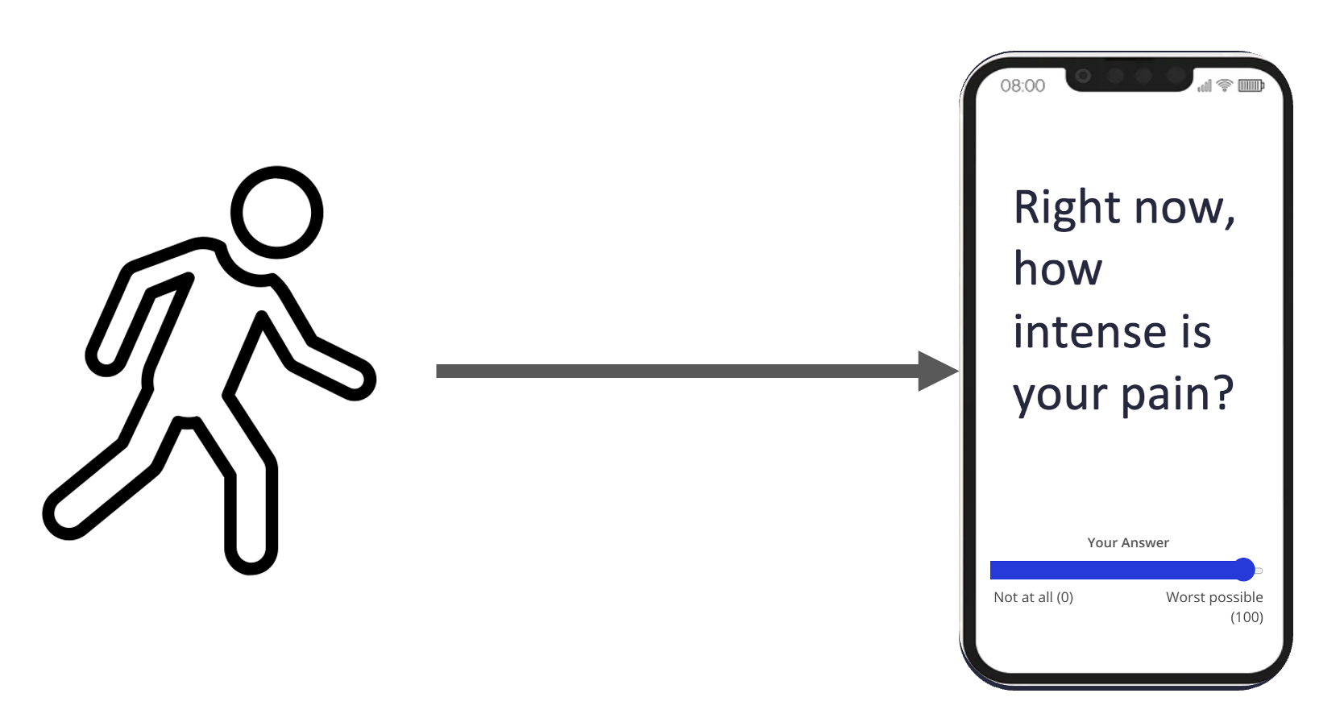

Digital assessment can facilitate phenotyping of heterogeneous chronic pain conditions
133 patients undergoing lumbar surgery for degenerative spine disease
In-vivo assessment of movement-evoked pain was among the strongest predictors of early postoperative outcomes
Preprint

Slide 9
Email: madelyn.r.frumkin@dartmouth.edu
Lab website: https://sites.dartmouth.edu/frumkin-lab/

